Slide 1
Success in the Valley and Beyond
Frederick U. Fierst, Esq.
Fierst, Kane & Bloomberg LLP
www.fierstkane.com

Slide 2
It can be done.

Slide 3
Kevin Eastman & Peter Laird

Slide 5
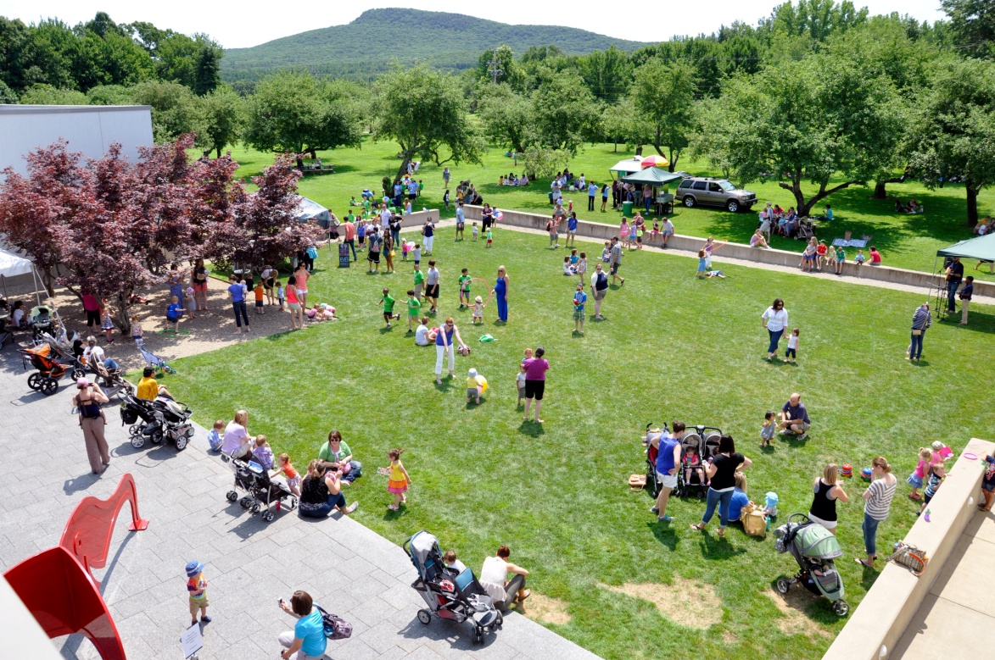

Slide 6
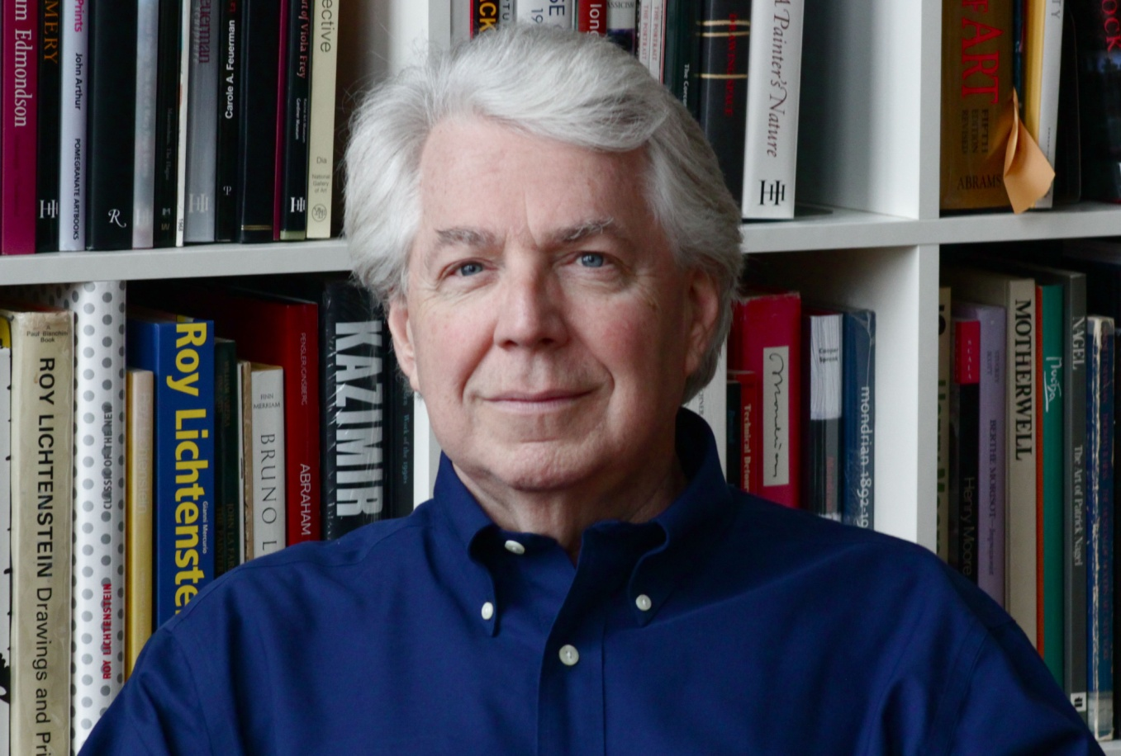

Slide 7
Joe Minton - Graduate of Hampshire College
Offices in San Francisco, Hong Kong, Osaka, Manchester, Eindhoven & Boston
World-Wide HQ in Northampton

Slide 8
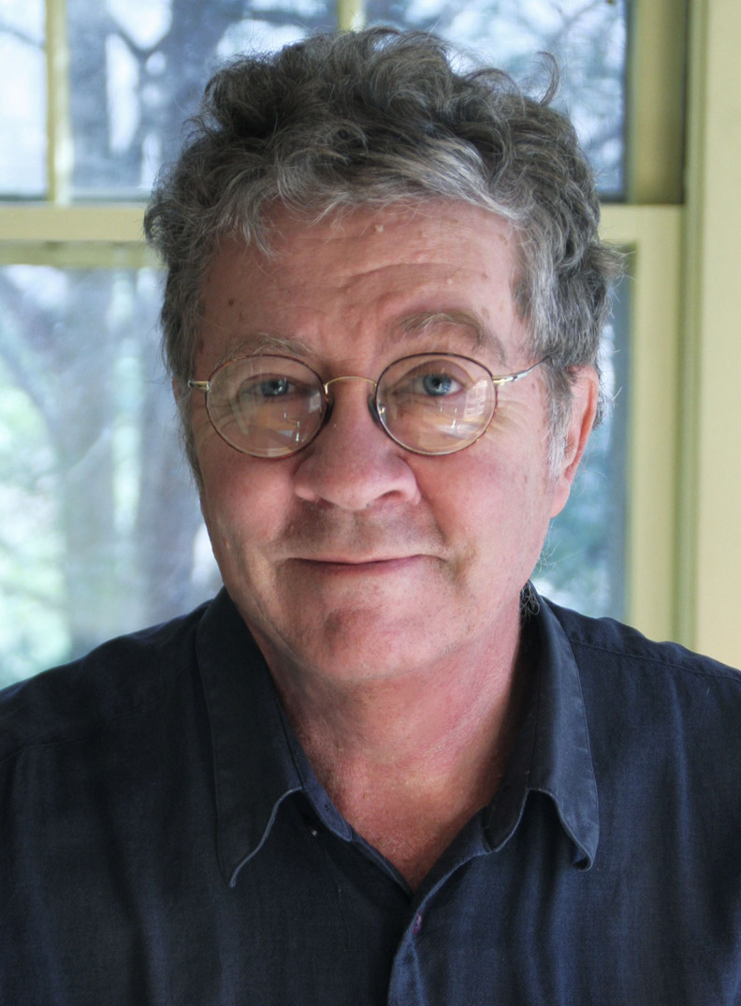
Scott Prior

Slide 9
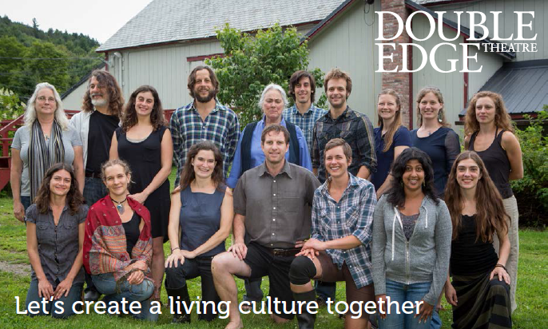
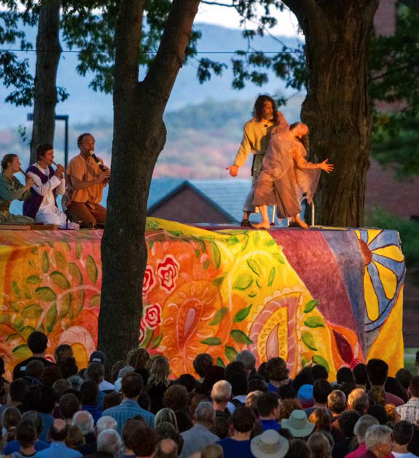
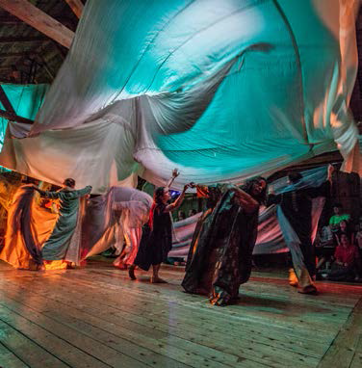

Slide 10
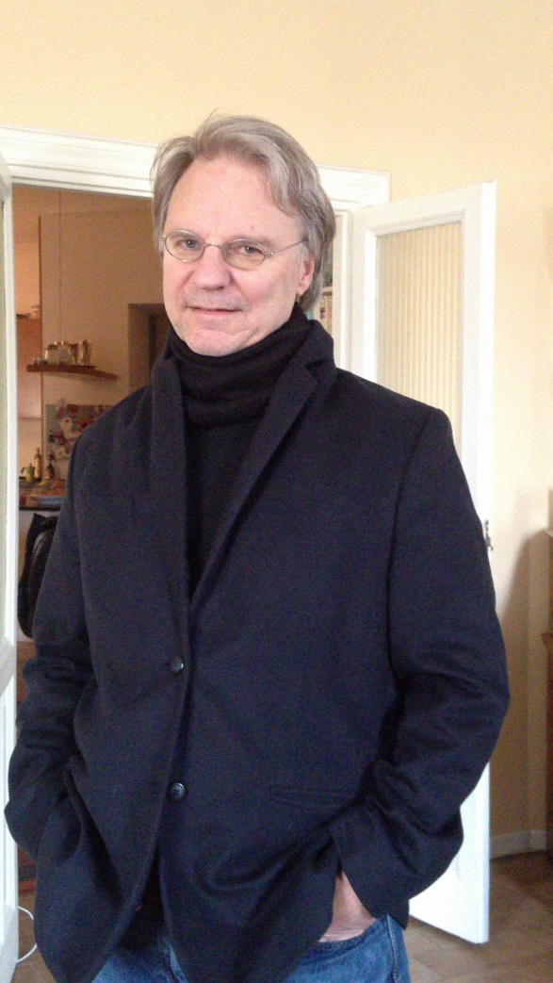
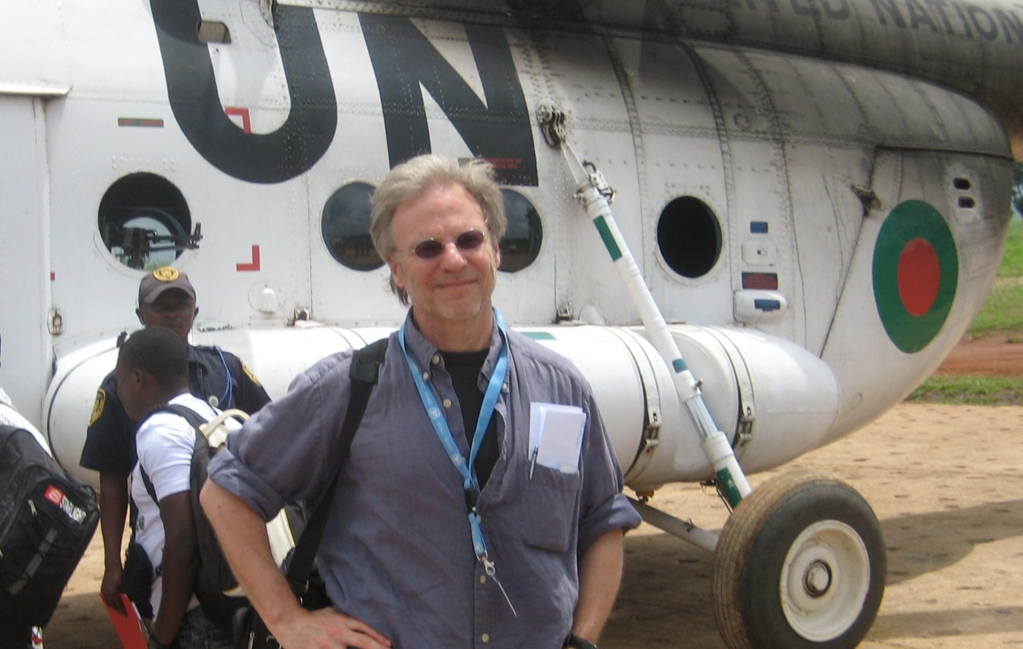
Jonathan Harr

Slide 12
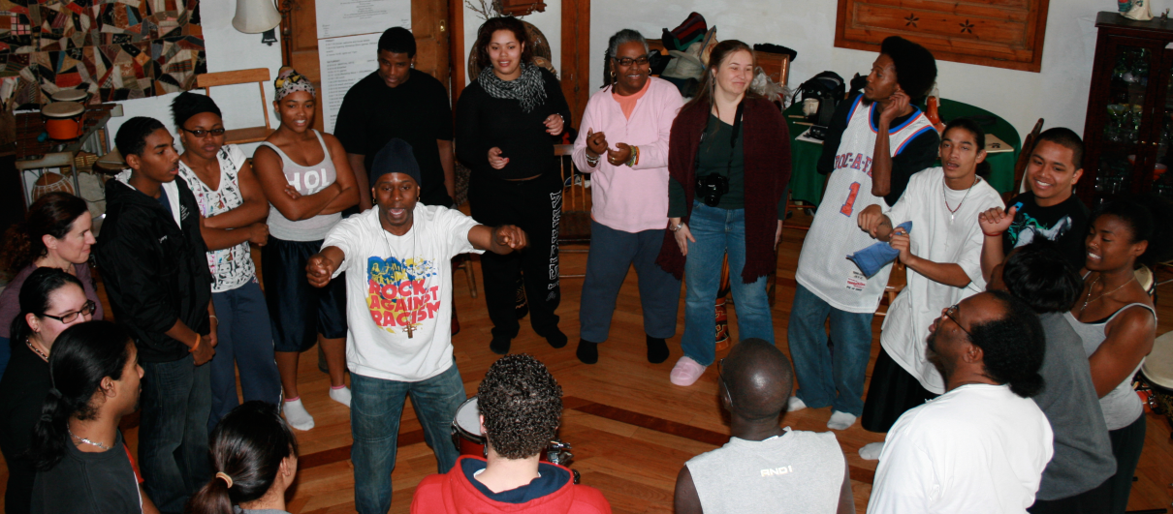
First Generation ♦ UBUNTU ♦ The Mural Project ♦ Visual Art Residencies

Slide 13
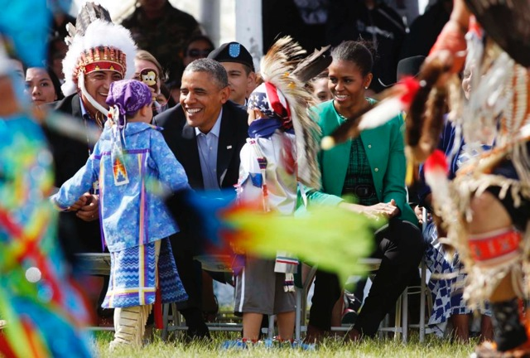

Slide 14
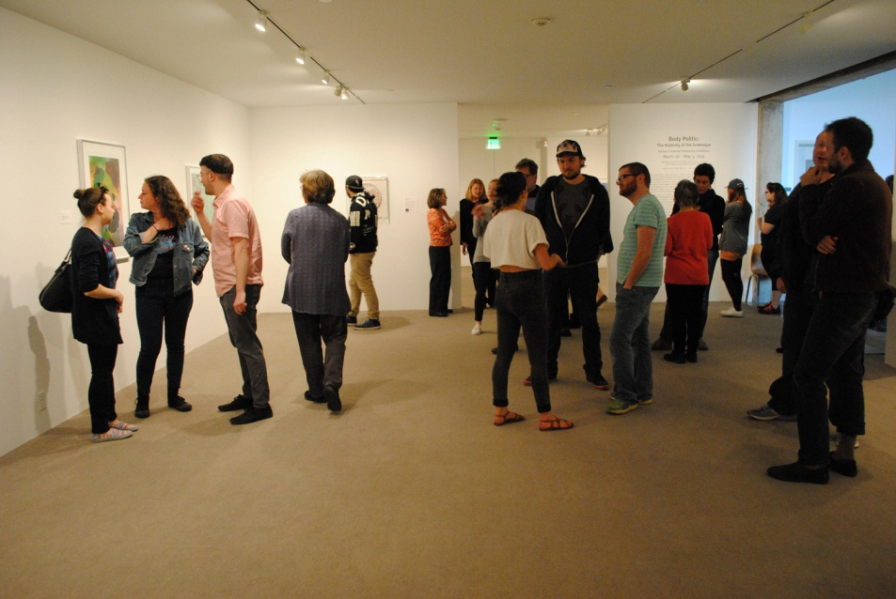

Slide 15
Common threads.

Slide 16
Focus on the creative.

Slide 17
Be prepared to travel.

Slide 18
You can get in to see anyone; once. Be prepared not to waste that chance. Work on your pitch.

Slide 19
Don’t make long-term commitments too quickly.

Slide 20
Dream. BIG.

