Slide 1
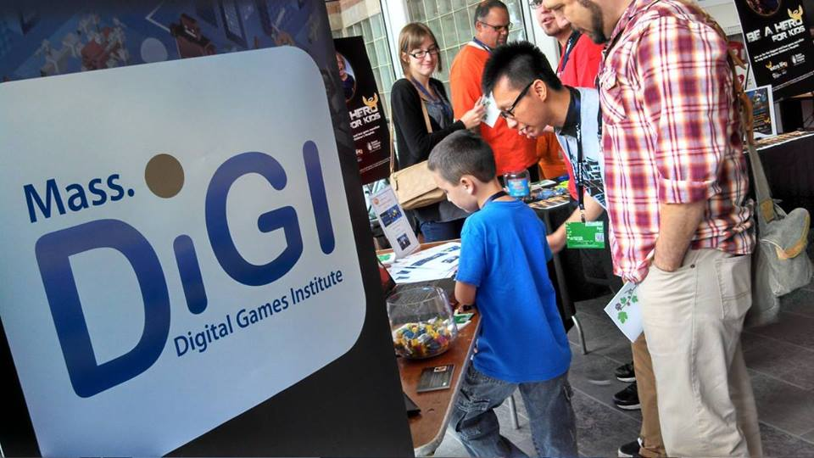


How
The State of Play
Creative Economy Summit
Greenfield, MA

Slide 2

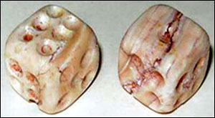
Dice - Iran, c. 3000 BC

Slide 3
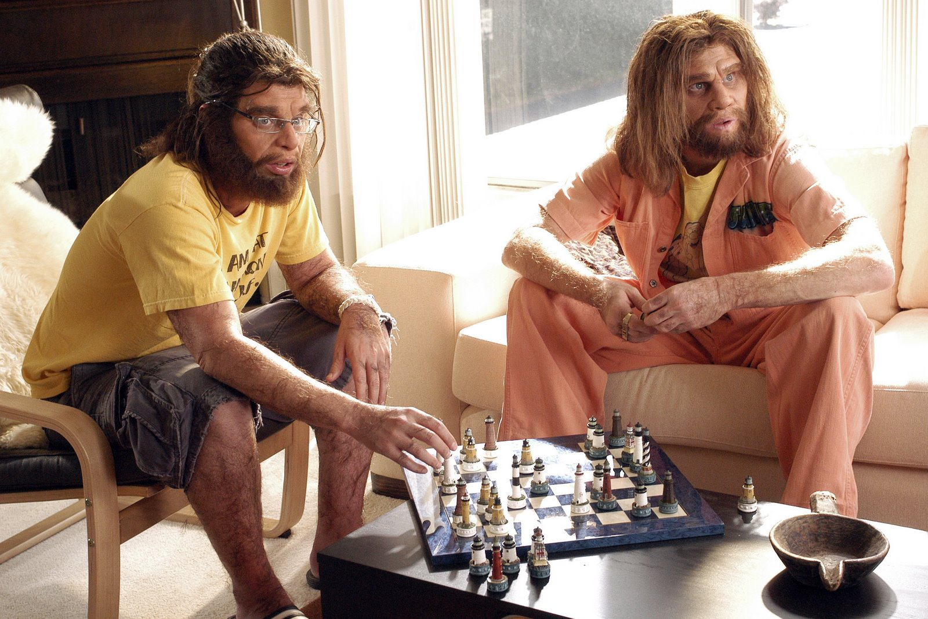
Chess - India, c. 550

Slide 4
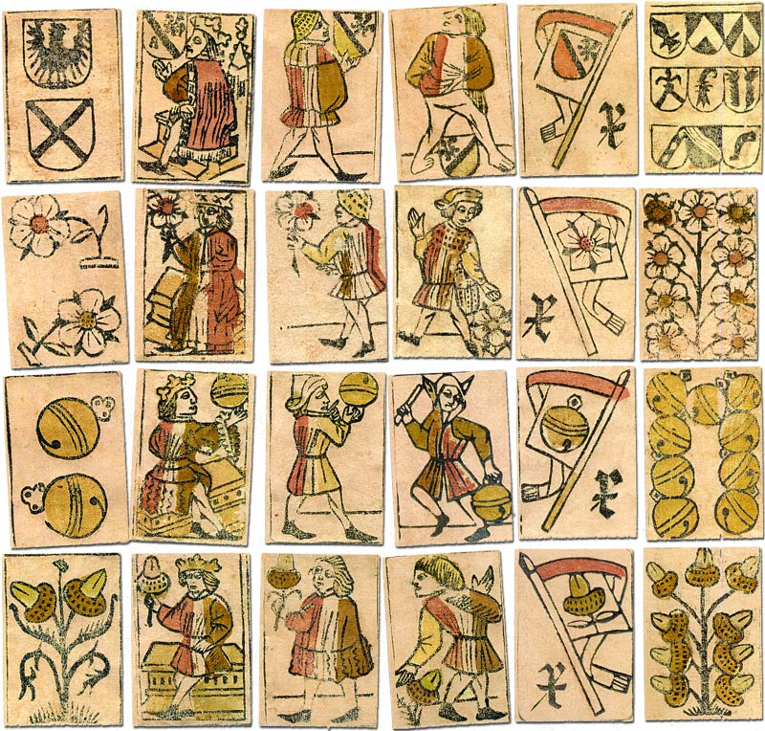
Cards – Europe, c. 1530

Slide 5

c. 1937

Slide 6

D & D, c. 1974

Slide 7
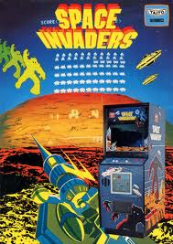
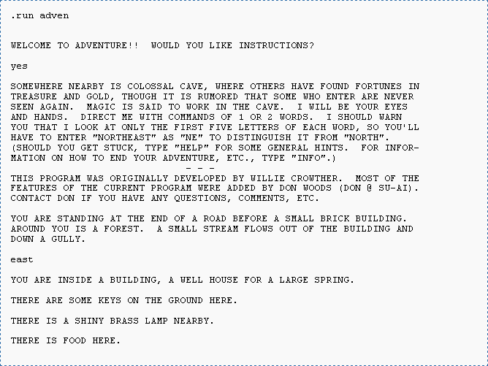
Space Invaders, 1978
Adventure, 1977

Slide 8
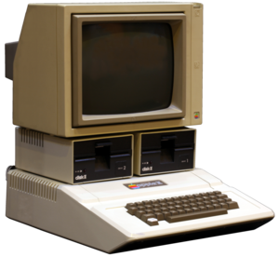
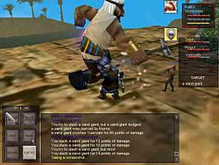
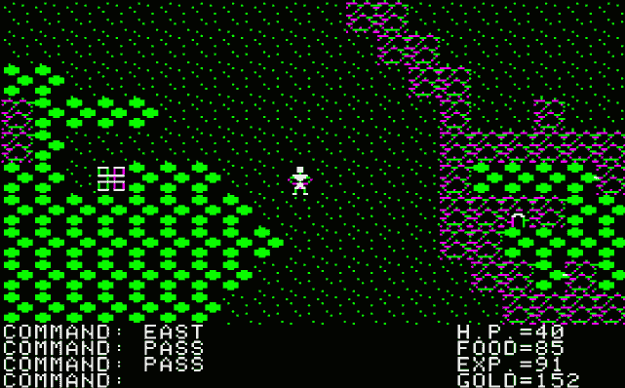
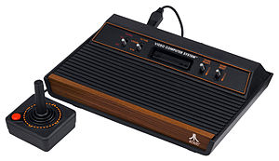
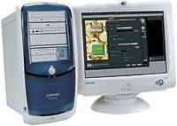

Everquest (Online), 1999
430,000 users, 2004
Ultima I, 1981
50,000 users, 1982

Slide 9


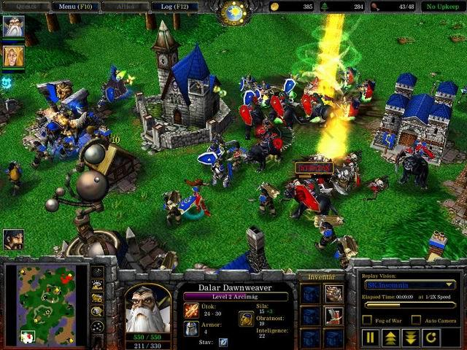
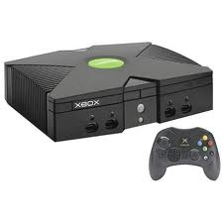
Call of Duty (franchise), 2003
175,000,000+ units, 2015
World of Warcraft (Online), 2004
10,000,000+ users, 2015

Slide 10



Facebook, 2004
1,400,000,000+ users, 2015
iPhone, 2007
700,000,000+ units, 2015
Android, 2007
2,000,000,000+ units, 2015
iPad, 2010
250,000,000+ units, 2015

Slide 11
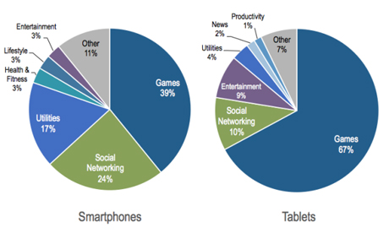
Flurry

Slide 12
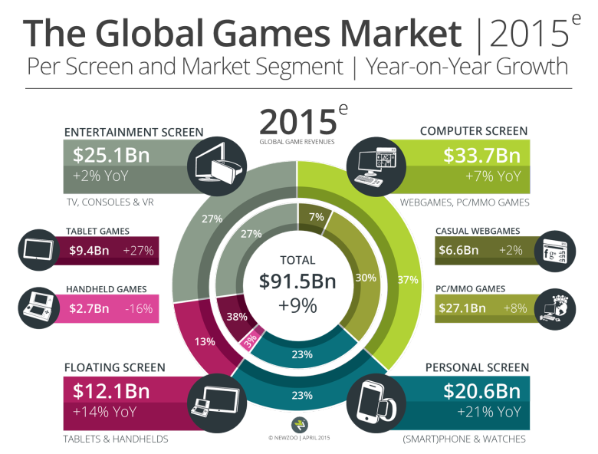

Slide 13

The Opportunity
Ubiquitous & pervasive technology
Creative, innovative & inventive
Cross-disciplinary
Global markets
Vast potential for growth & expansion

Slide 14
Industry
Academia
Government
About MassDiGI
Based at Becker College
Exercise in leadership
Private, public sectors & academia
Established in April 2011
Statewide center for entrepreneurship, academic cooperation & economic development across the games ecosystem
Notes:
People, resources and ideas

Slide 15
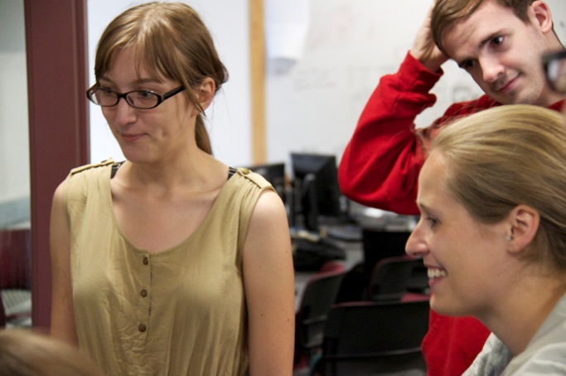
MassDiGI Mission
Prompt collaboration among academia, industry & government
Strategically foster growth & development
Promote & enhance initiatives between higher education & business that enhance the industry cluster

Slide 16
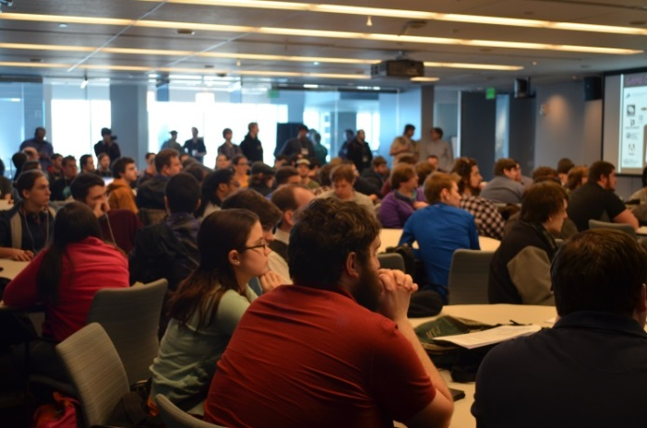
MassDiGI Programs & Services
Business & workforce development
Game Challenge
Summer Innovation Program
Mentoring
Education & research
LiveCode
Outreach & industry marketing
PAX East
Unity 3D Unite
GDC
Practices, policy & advocacy

Slide 17

Challenges [Solutions]
Talent [Programs and activities]
Business development [Networking]
Visibility [Media]
Access to capital [Bootstrapping, crowdfunding, angel, VC]
Space [Partnerships and collaborations]

Slide 18

What’s next?
Being creative is a competitive advantage
Creative talent will drive our local and regional economies to an even greater extent
Be it in marketing, architecture, visual arts & crafts, design, film, media, publishing, music & entertainment, the future is brighter than ever

Slide 19



Cat Tsunami
Notes:
CatTsunami video

Slide 20
Thank you
timothy.loew@massdigi.org
www.massdigi.org
Follow us on Twitter @mass_digi
Like us on Facebook/massdigi

