Slide 1

EST.1985
envisions a just world where all people can realize their full creative potential
Notes:
*
“AS220 was founded in 1985 with an unjuried, uncensored mission and the conviction that freedom of expression is crucial for the development of strong communities and individual spirits. In the past 25 years, AS220 has grown to become a linchpin of Providence's vibrant creative community, with three buildings downtown that provide a performance space, four galleries, 48 artist live or work studios, a community print shop, a community darkroom, media lab, 95 Empire Black Box and performing arts school, a public technology lab and a youth program. We showcase more than 100 visual artists and host thousands of performing artists annually, including poetry readings, film festivals, panel discussions and music of all genres.”
Source: Cheryl Kaminsky, Communications Director, AS220, Cheryl@AS220.org

Slide 2

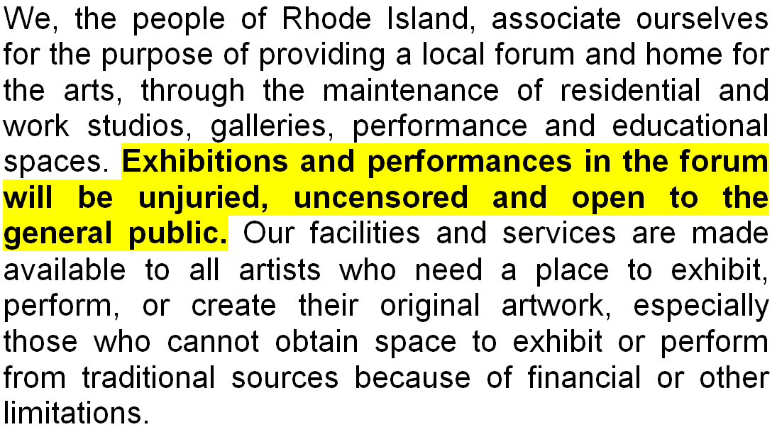
MISSION

Slide 3
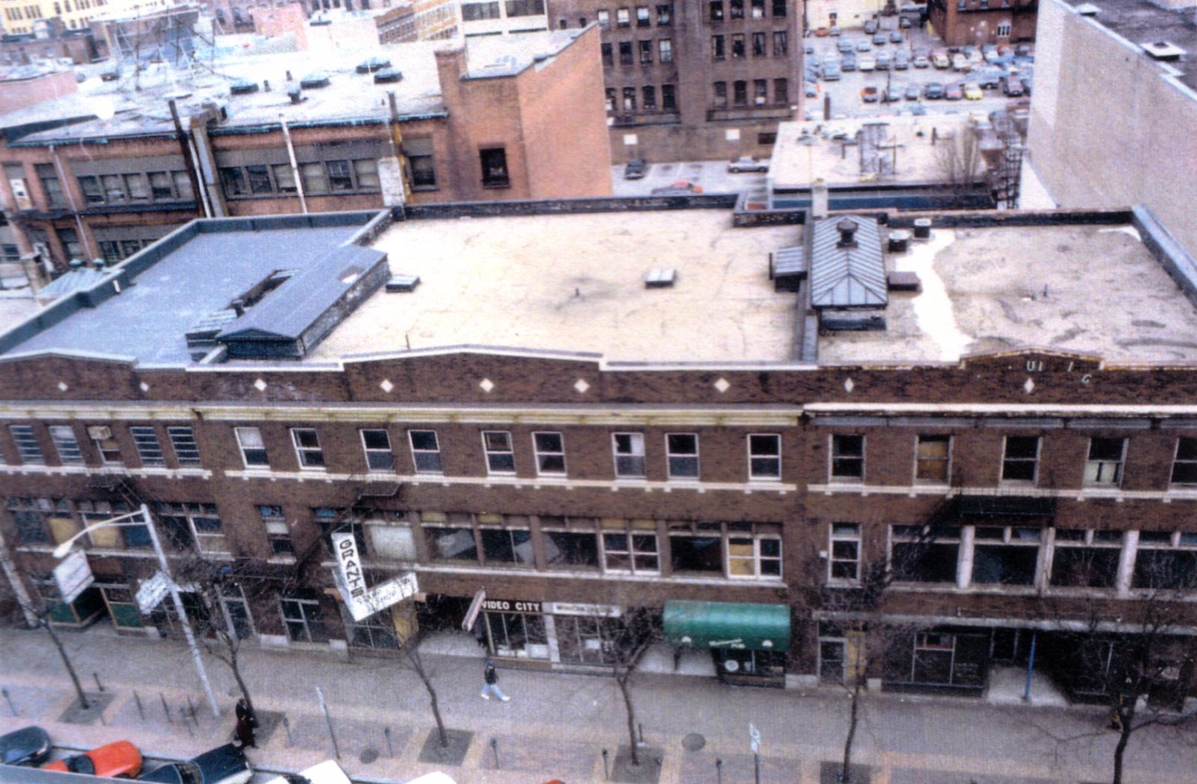
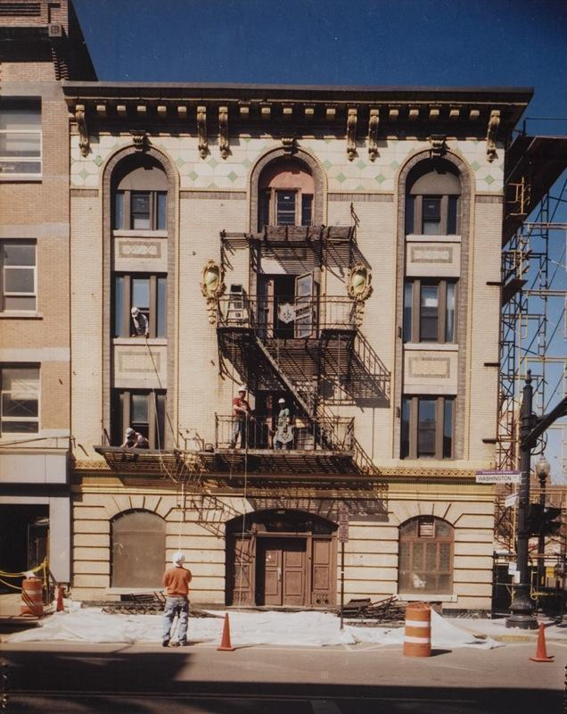
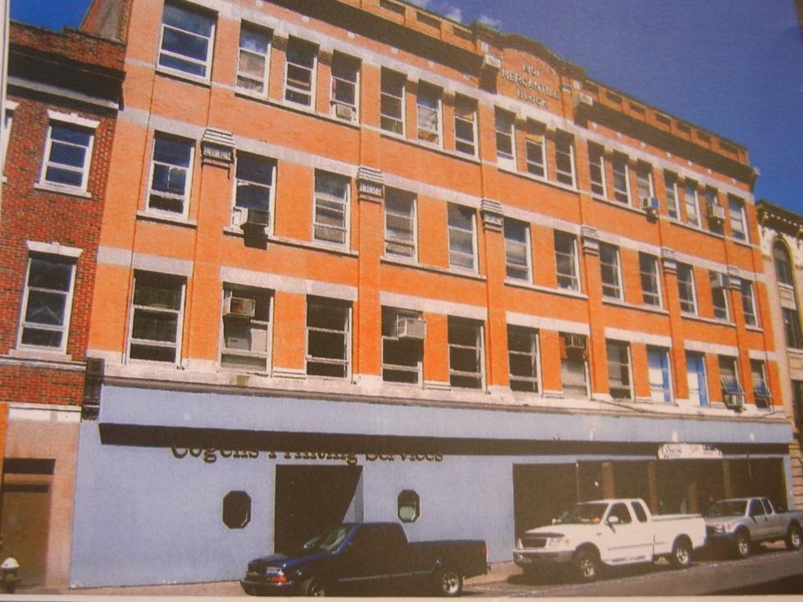
BEFORE
ANTES / BEFORE

Slide 4
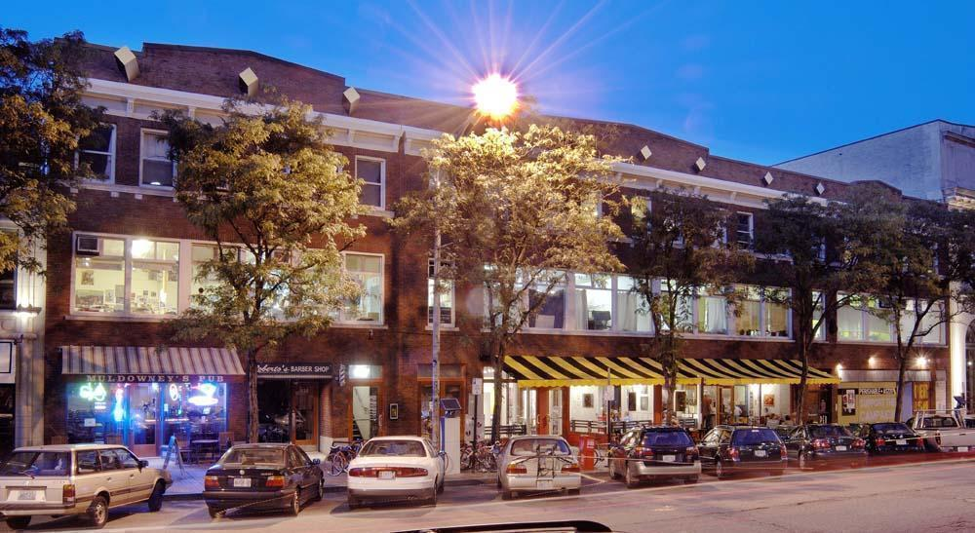
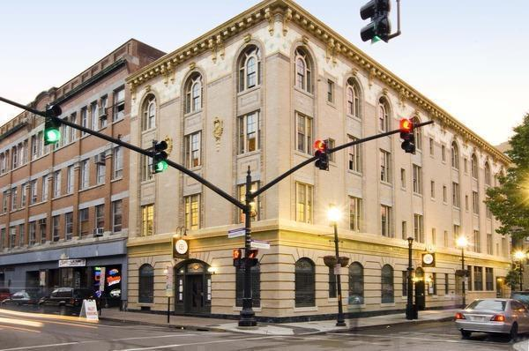
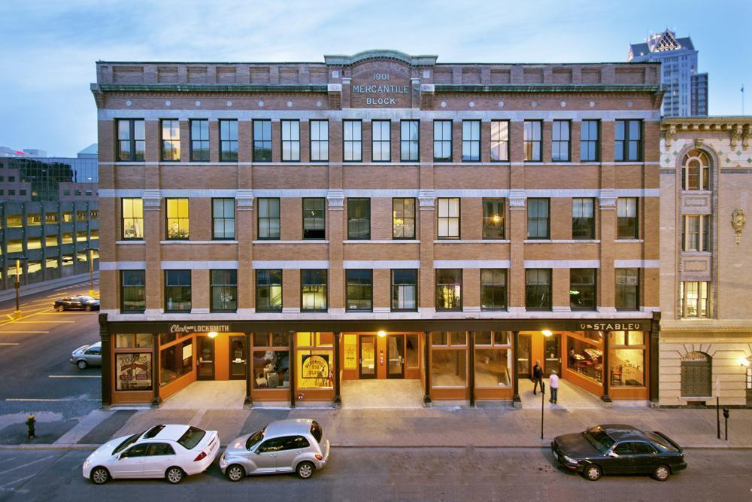
TODAY
1993
2007
2010

Slide 5
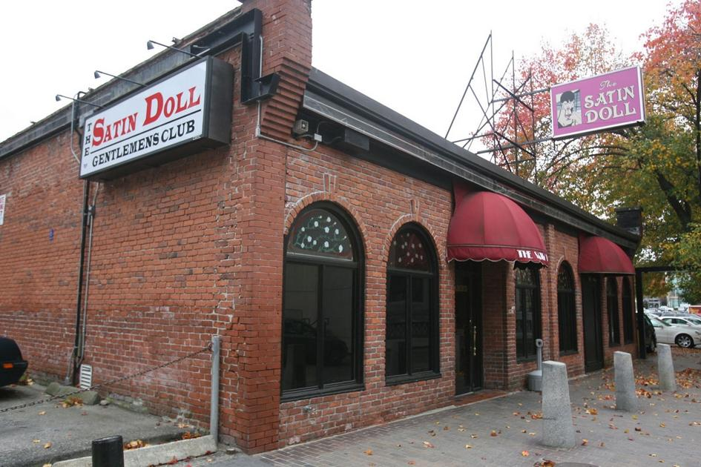
FUTURE

Slide 6
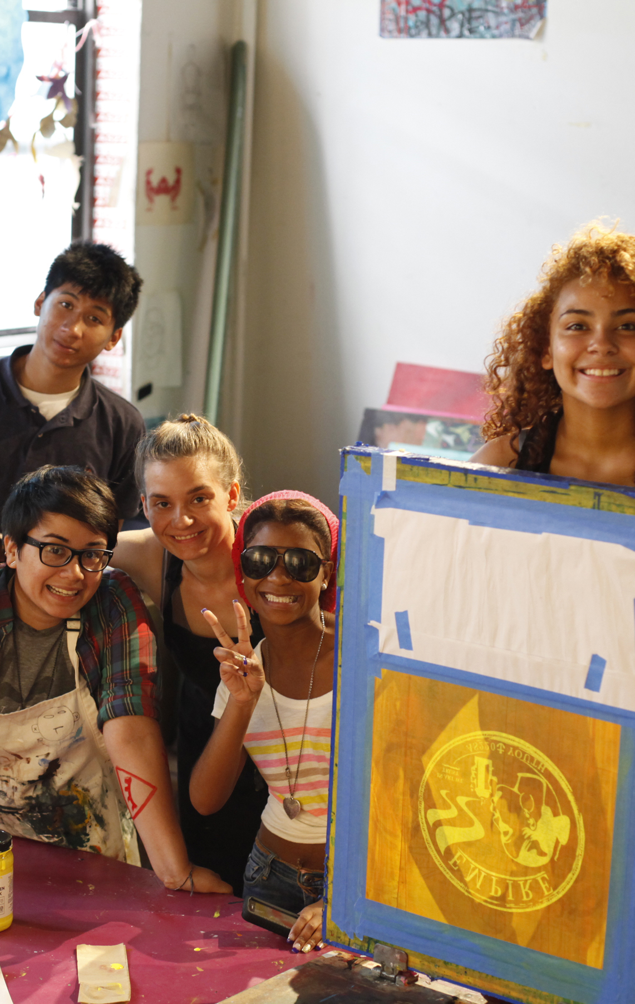
PROGRAMS
+ GALLERIES
+ LIVE ARTS
+ AS220 YOUTH
+ INDUSTRIES
+ LIVE/WORK
+ FOO(D) & THE BAR
+ FOO FEST

Slide 7
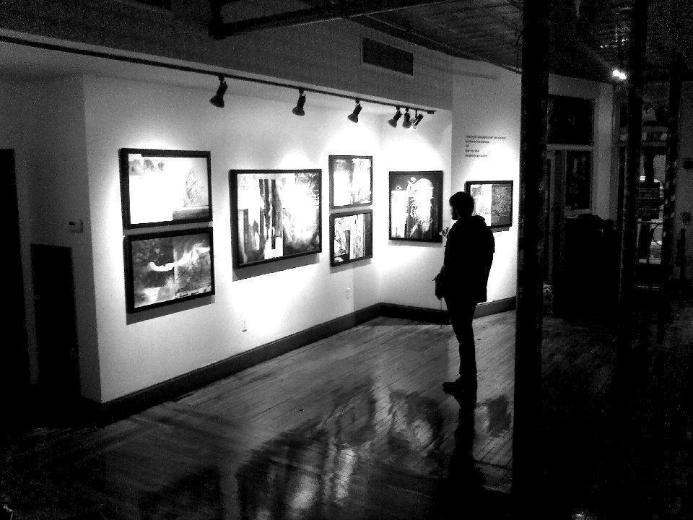
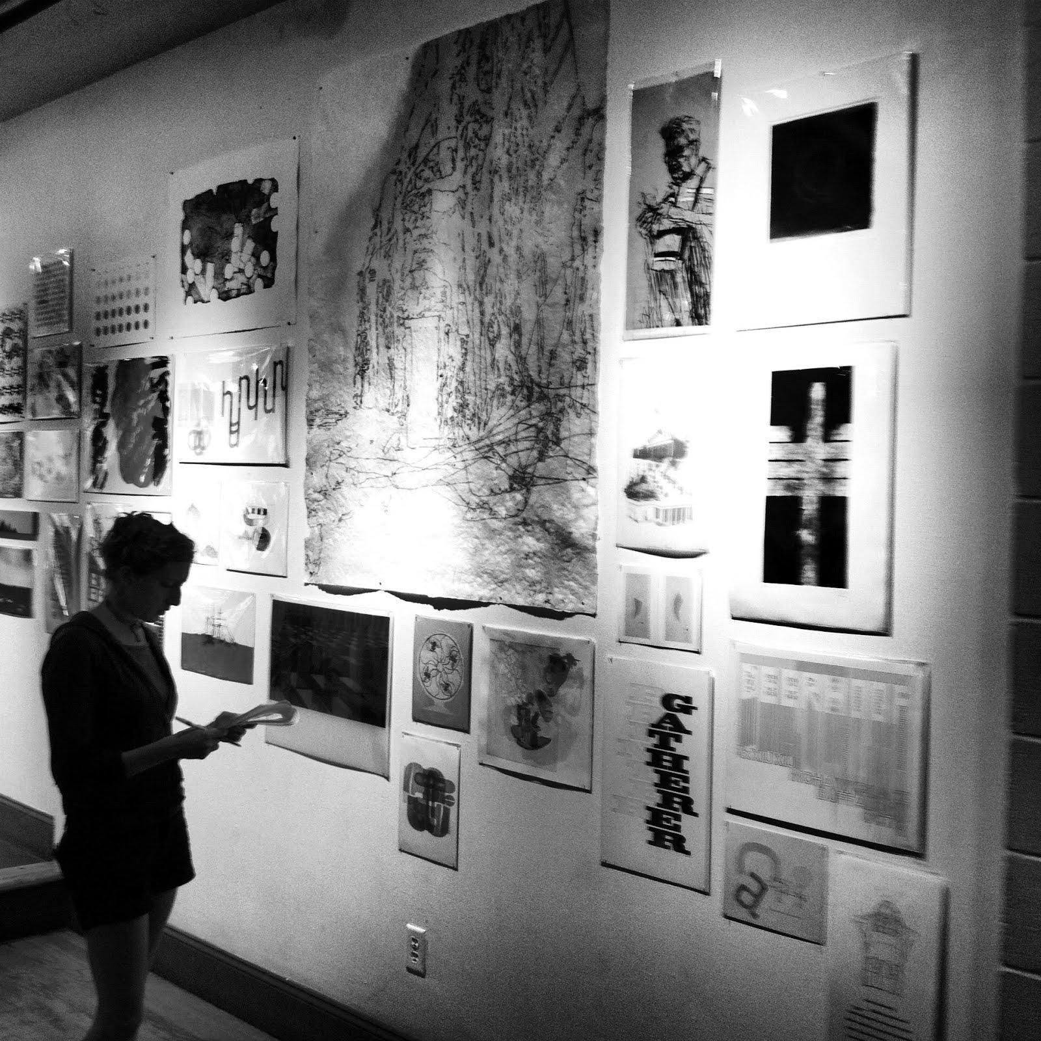
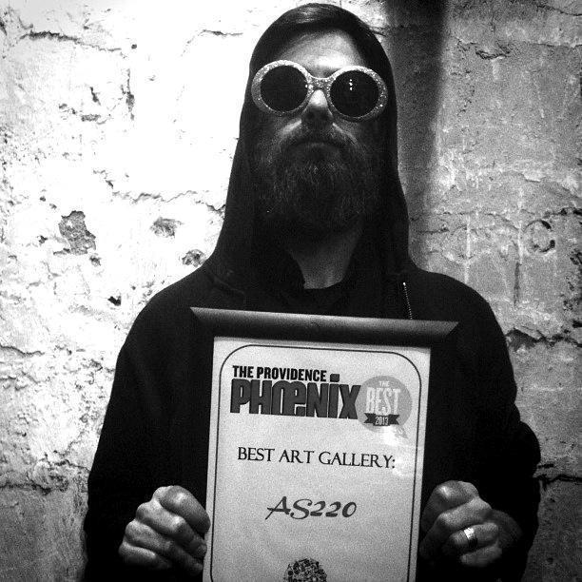
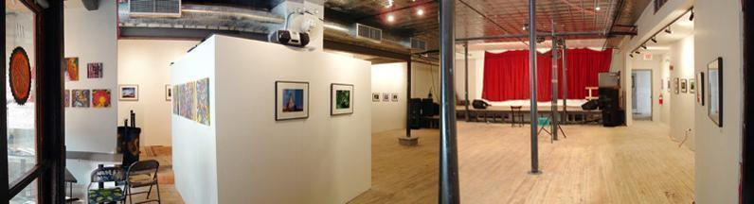
GALLERIES

Slide 8
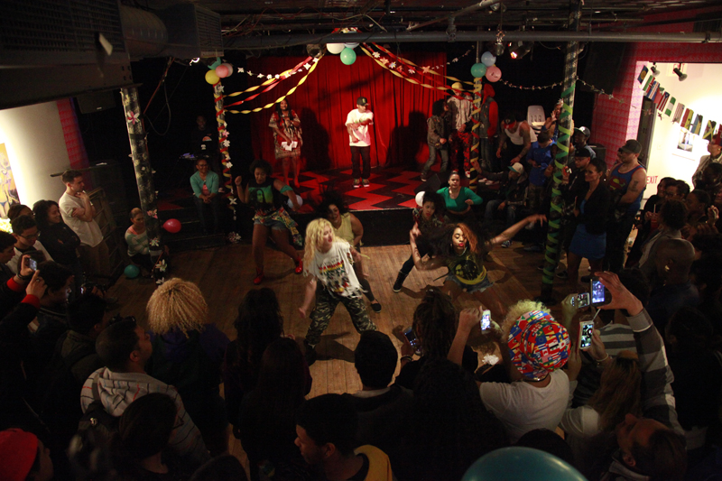
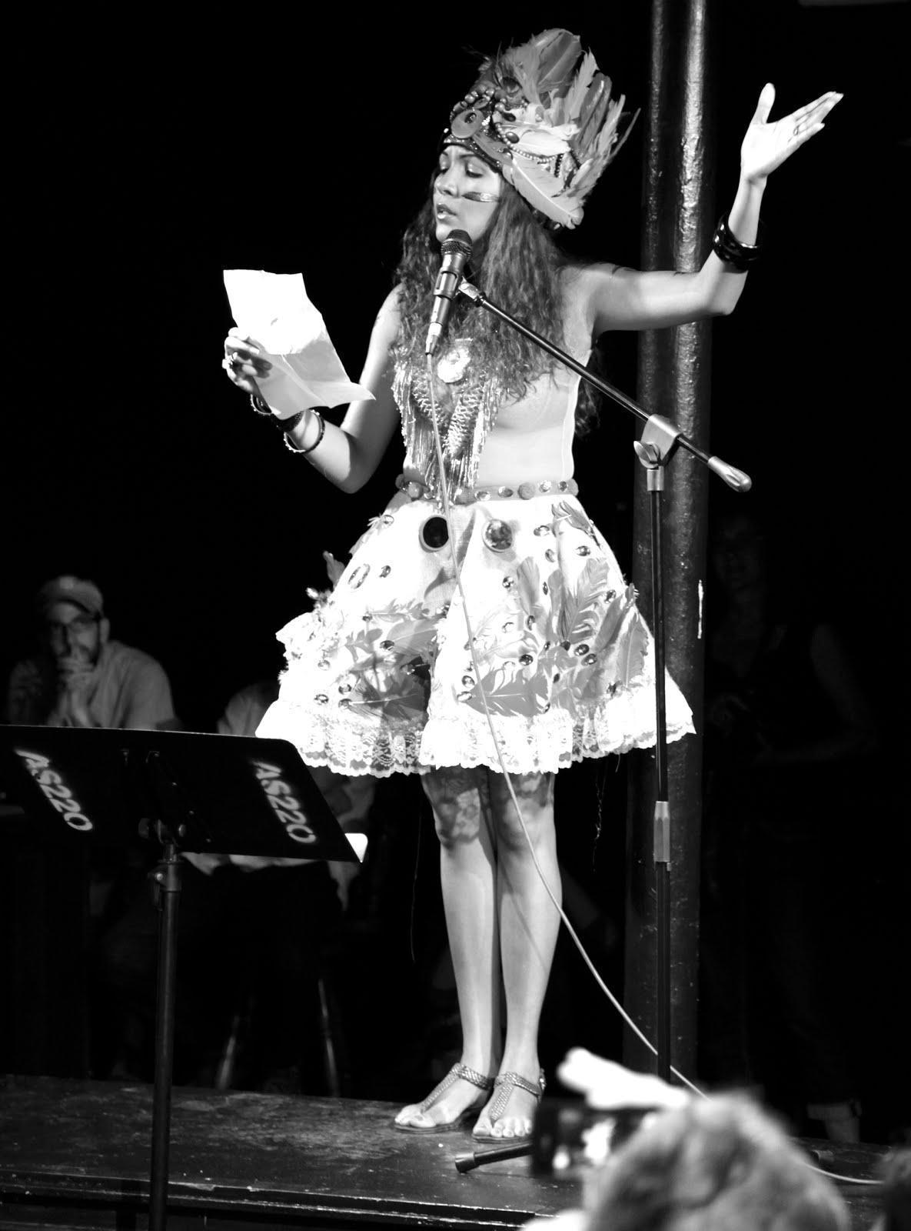
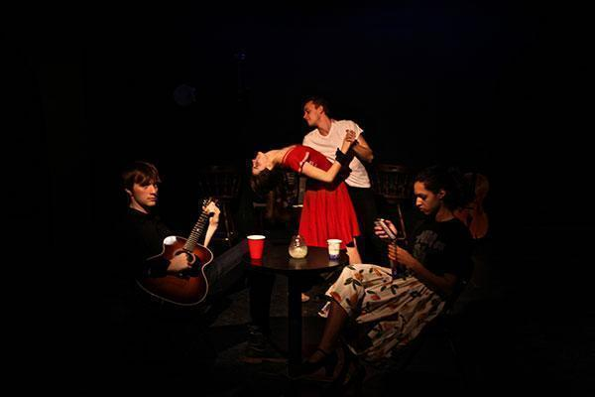
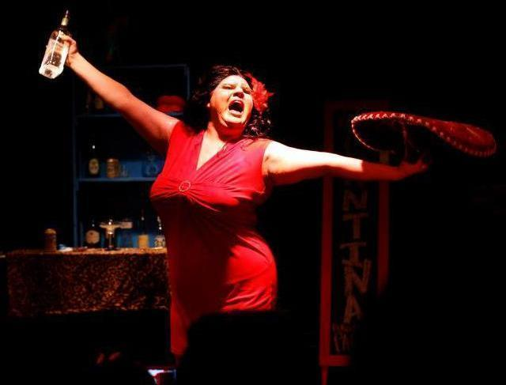
LIVE ARTS
Notes:
(2003-2009)
“Verse was a hardcore band from Providence, RI, United States. They were signed to Bridge Nine Records.
Previously released “Rebuild” and “From Anger And Rage” on Rivalry Records. Aggression is now out on Bridge Nine Records.
Verse played their final 3 shows on the nights of Thursday, Friday, and Saturday May 21-23 2009 in Providence. The Thursday show was held in the singer of Soul Control’s basement. The last two shows were played at AS220 in Providence with Shipwreck AD, I Rise, Product of Waste, Learn, The Body, Soul Control, Wasteland, and Crime in Stereo.”
Source: http://www.last.fm/music/Verse

Slide 9
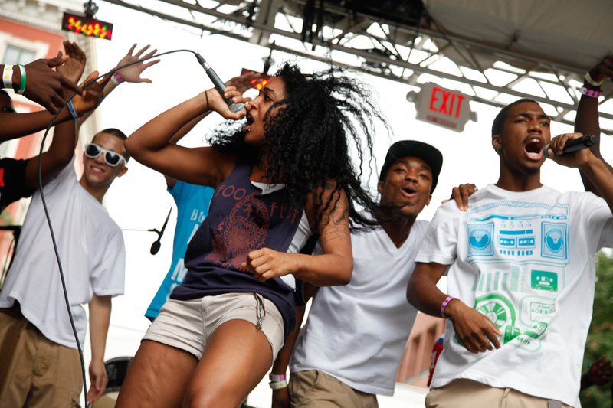
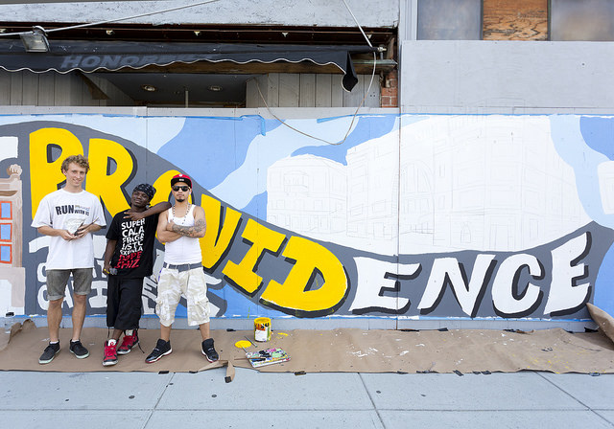
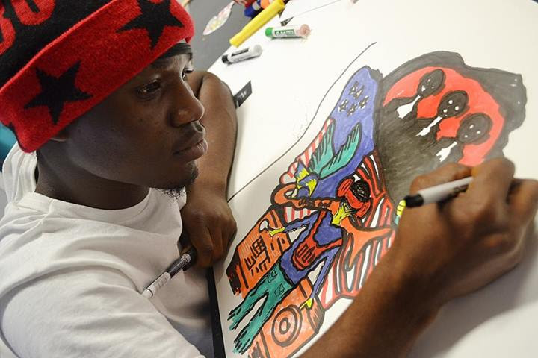
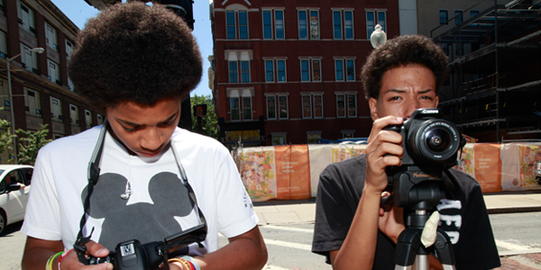
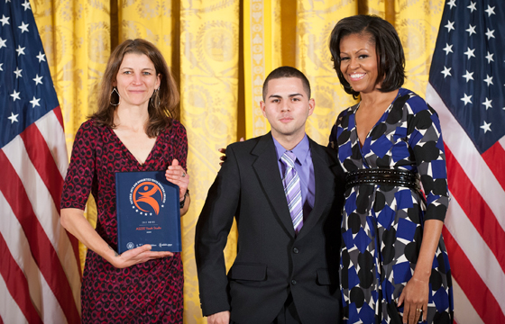
AS220 YOUTH
Notes:
“In 1998, AS220 wanted to incorporate more young people into its community. Reaching out the to Rhode Island Training School (RITS), the state’s juvenile detention facility, AS220 began to provide arts programming to incarcerated young men and women.
By 2000, the energy and momentum around AS220’s arts education program at the RITS had grown to such an extent that a physical space apart from the RITS was needed. A large industrial space was rented on Providence’s Southside, and the Broad Street Studio was born.”
Source: AS220yothstudiohomepage

Slide 10
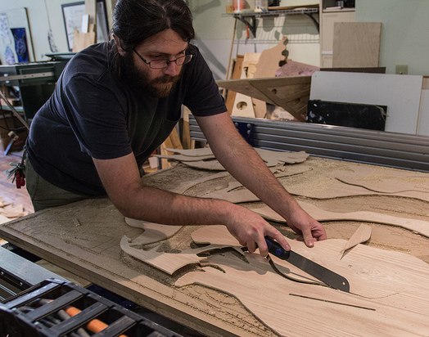
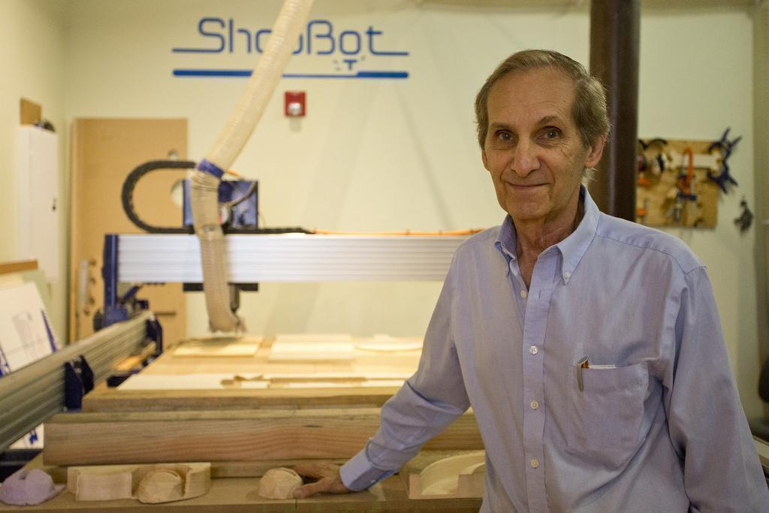
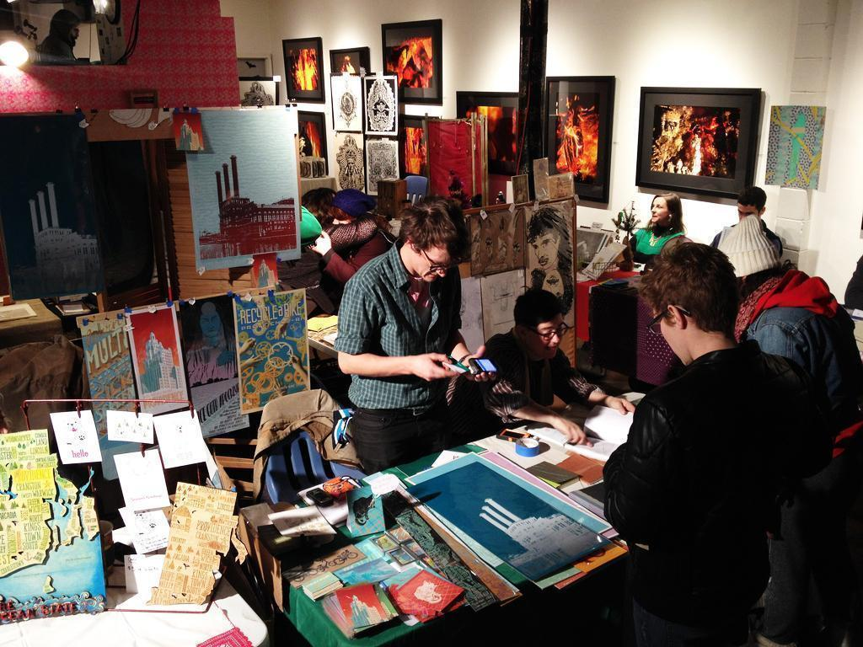
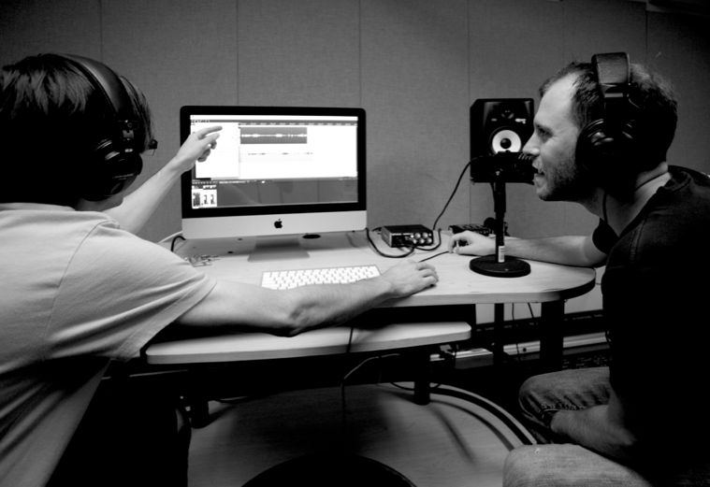
INDUSTRIES
FAB LAB
PRINTSHOP
MEDIA ARTS

Slide 11
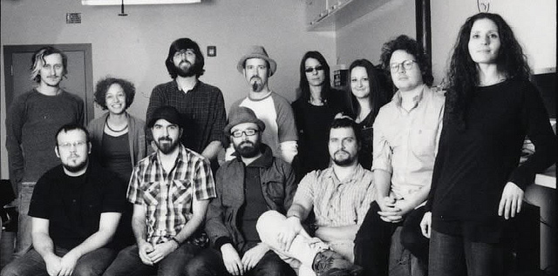
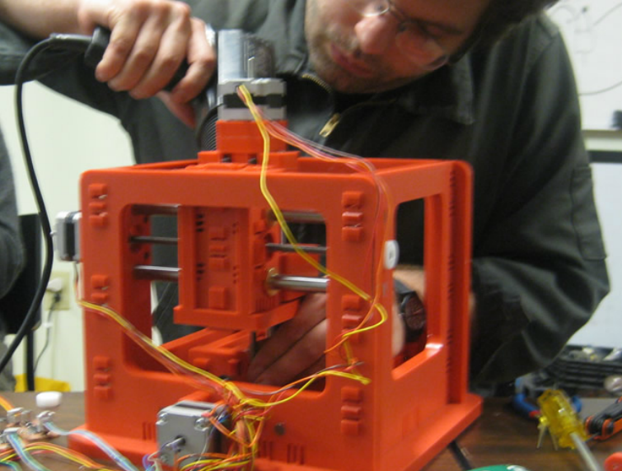
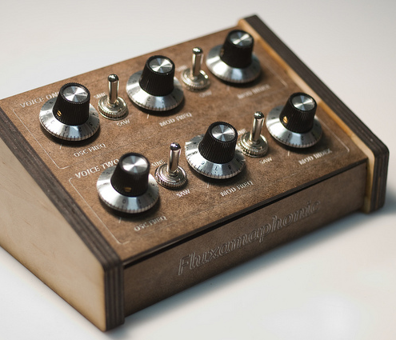
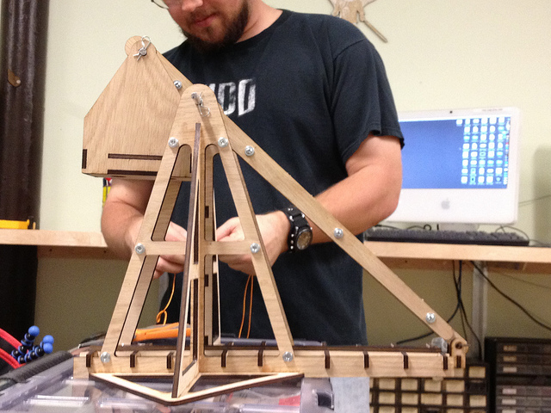
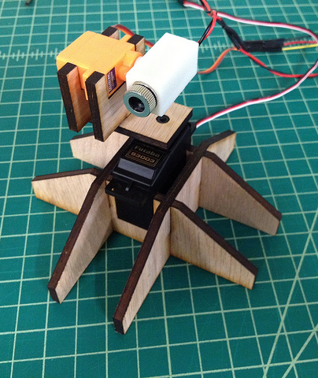
FAB ACADEMY
Notes:
Shawn Wallace will provide fab academy photos.

Slide 12
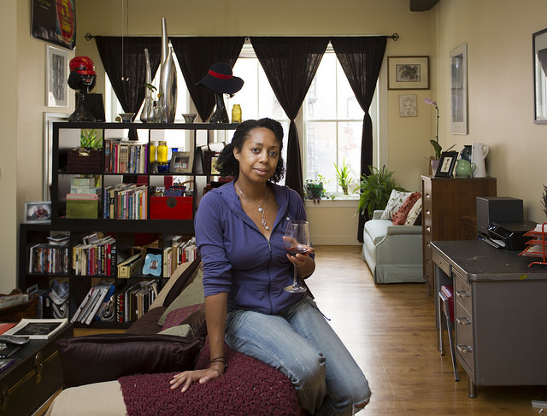
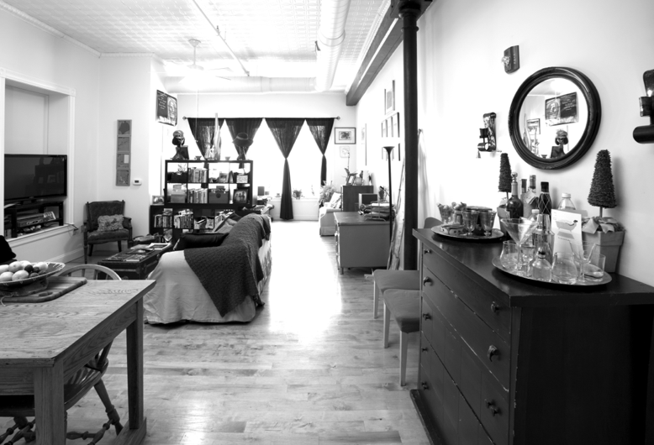
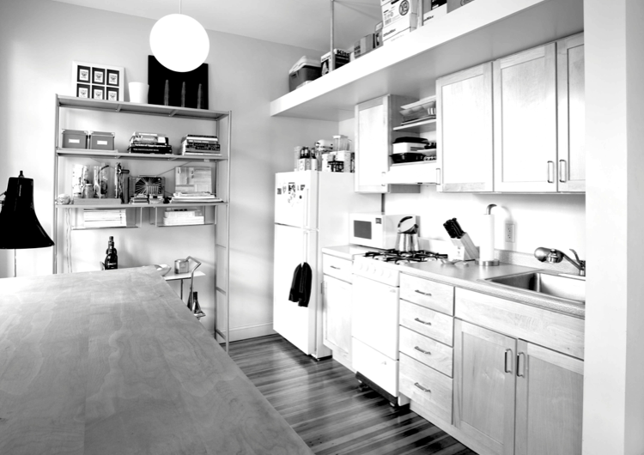
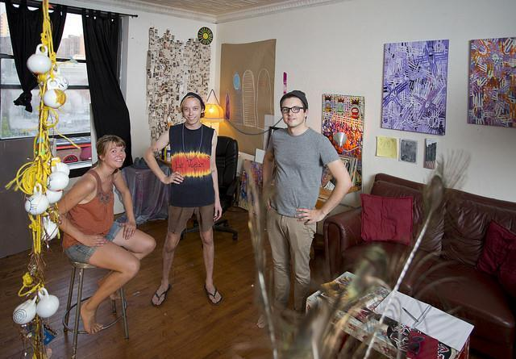
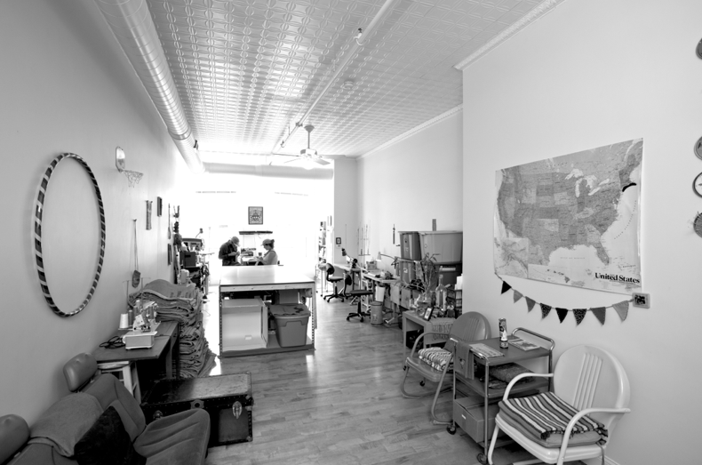
LIVE/WORK

Slide 13
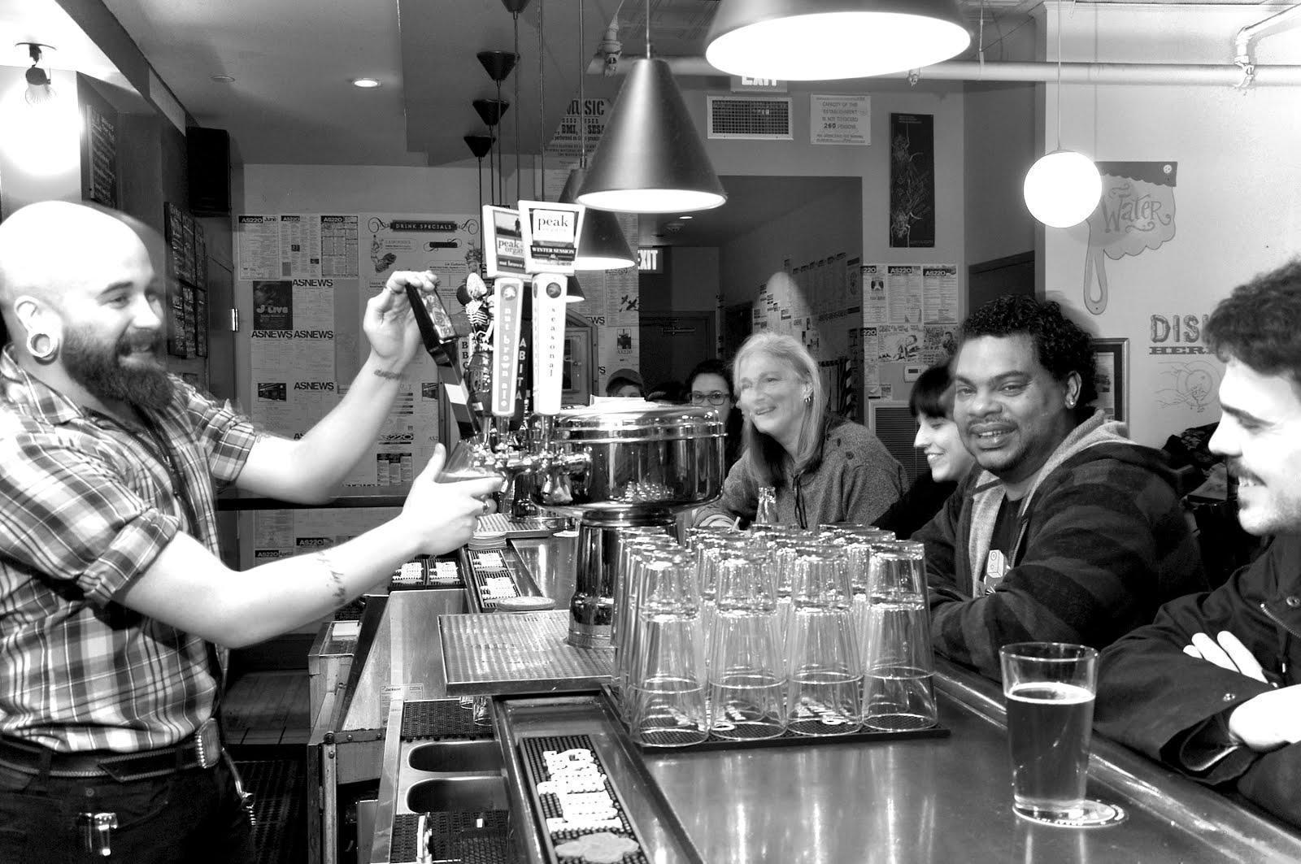
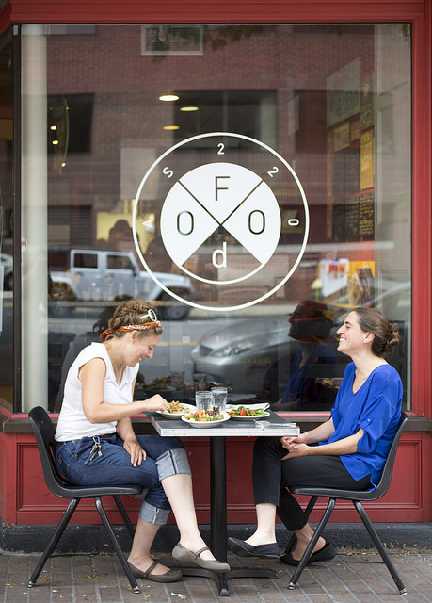
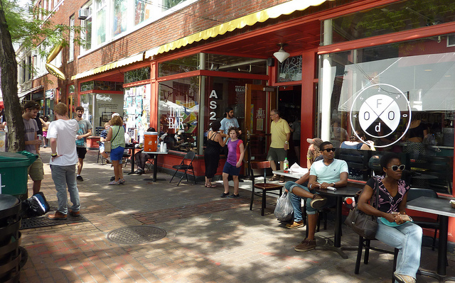
FOO(D) & THE BAR

Slide 14
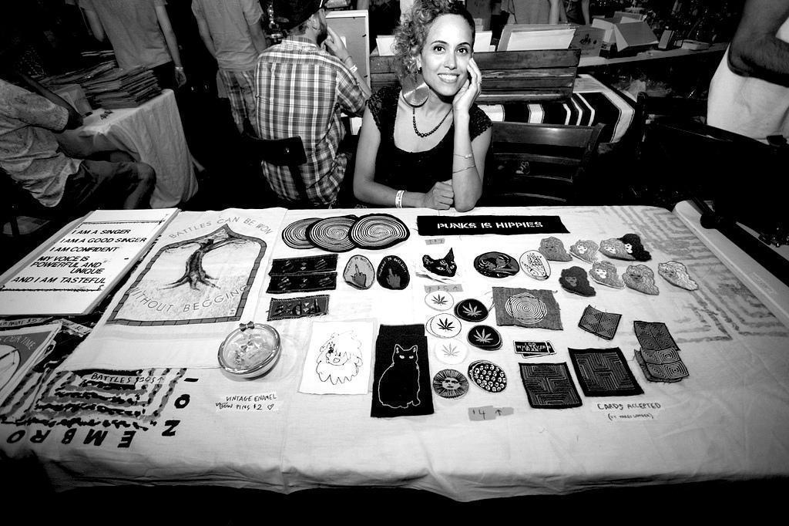
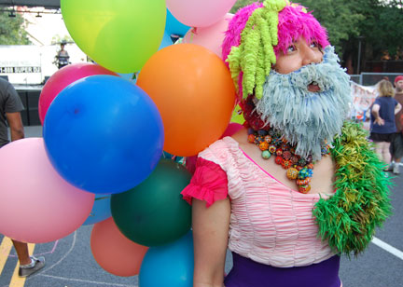
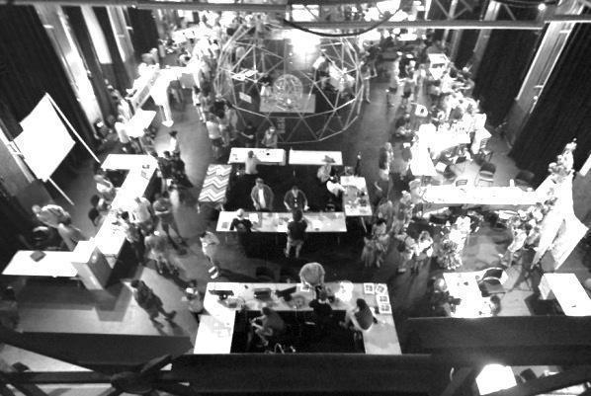
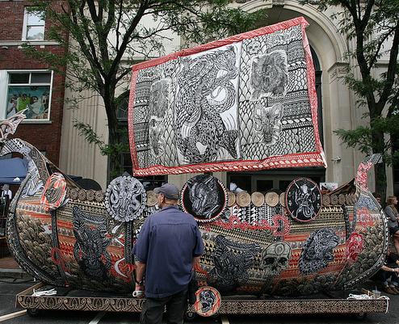
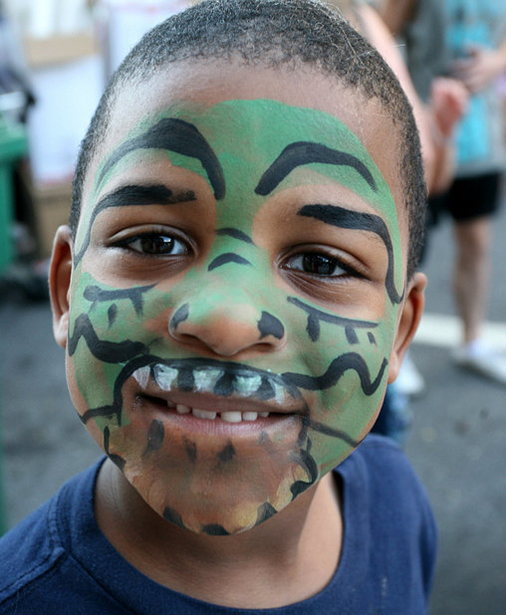
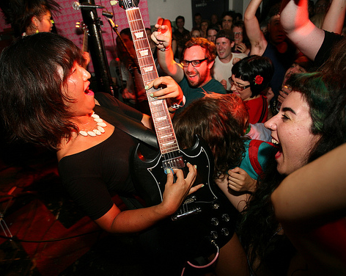
FOO FEST

Slide 15
YEARLY ACTIVITY
20+ active artist businesses
50+ artists living in our buildings
60+ art exhibits
250+ Industries Members
450+ classes
500+ performance/music events
600+ youth served at AS220 Youth
5,000+ artists performed
54,000+ attendance
100,000 sq/ft of space
100% occupancy

Slide 16
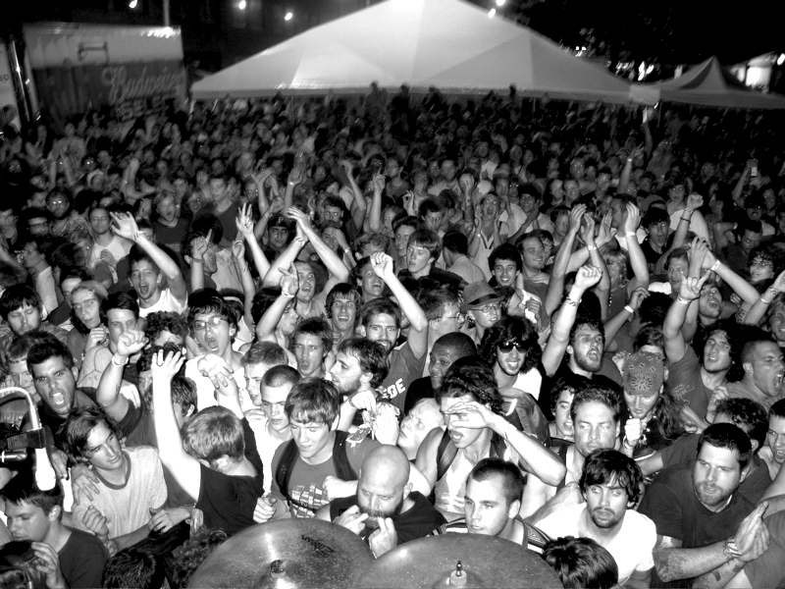
Sustainability Through Engagement

Slide 17
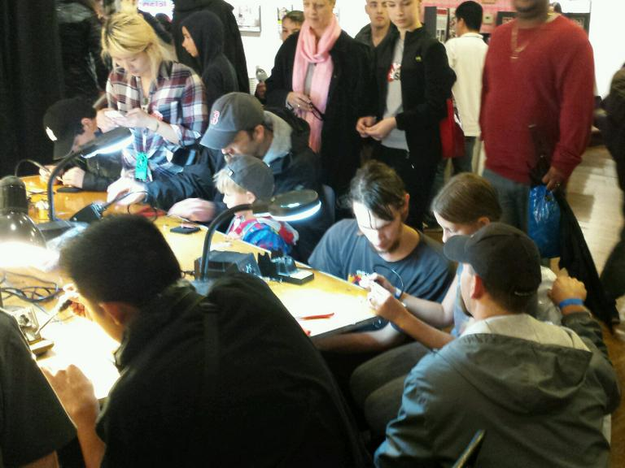
Engagement
+ Participation in programs
+ Financial support
+ Partnerships
+ Program development
+ Volunteerism
+ Advocacy

Slide 18
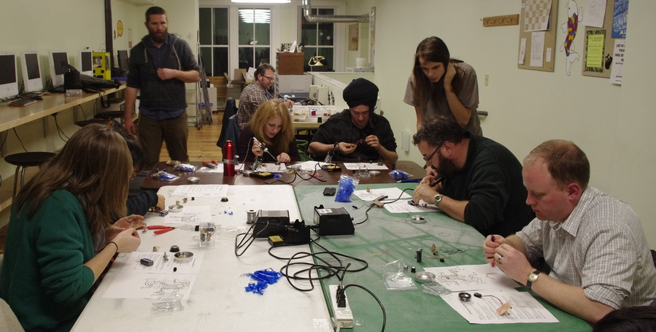
Sustaining Creative Communities
{
+ Affordable space
+ Knowledge
+ Tools & technologies
+ Other people
ACCESS

Slide 19
Top Down
ART & CULTURE
A MEANS TO AN END
OR A MEANS TO A MEANS?
Scaffolding for Success
Compost Theory
Conditional
Conceptual
Space
Intentional
Physical Space
Virtual Space
Bottom Up

Slide 20
